Slide 1
Risk-Neutral Pricing
報告者:鍾明璋(sam)

Slide 2
5.1 Introduction
5.2: How to construct the risk-neutral measure in a model with a single underlying security. This step relies on Girsanov’s Theorem. Risk-neutral pricing is a powerful method for computing prices of derivative security.
5.3: Martingale Representation Thm.
5.4: Provides condition that guarantee that such a model does not admit arbitrage and that every derivative security in the model can be hedged.

Slide 3


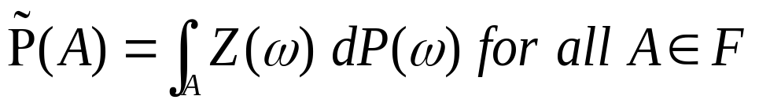
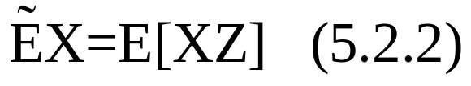
5.2 Risk-Neutral Measure
5.2.1 Girsanov’s Theorem for a Single Brownian Motion
Thm1.6.1:probability space Z>0；E[Z]=1
We defined new probability measure
(5.2.1)
Any random variable X has two expectations:

Slide 4

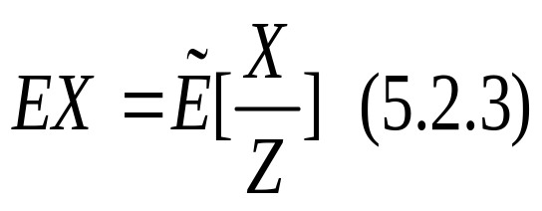
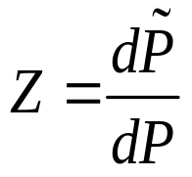
5.2.1 Girsanov’s Theorem for a Single Brownian Motion
If P{Z>0}=1，then P and agree which sets have probability zero and (5.2.2) has the companion formula
  Z is the Radon-Nikody’m derivative of
  w.r.t. P, and we write

Slide 5
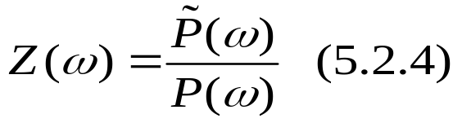

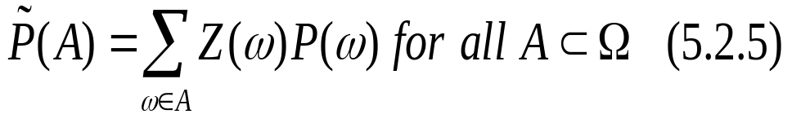

5.2.1 Girsanov’s Theorem for a Single Brownian Motion
In the case of a finite probability model:
If we multiply both side of (5.2.4) by and then sum over in a set A, we obtain
In a general probability, we cannot write (5.2.4) because is typically zero for each individual .

Slide 6

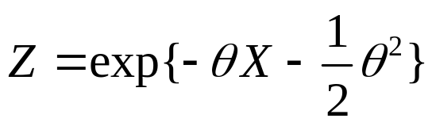

5.2.1 Girsanov’s Theorem for a Single Brownian Motion
Example 1.6.6 show how we can use this change-of-measure idea to move the mean of a normal random variable.
X~N(0,1) on probability space
def: ; is constant.
By changing the probability measure, we changed the expectation but not changed the volatility.

Slide 7
5.2.1 Girsanov’s Theorem for a Single Brownian Motion
Suppose further that Z is an almost surely positive random variable satisfying E[Z]=1, and we define by (5.2.1). We can then define the
We perform a similar change of measure in order to change mean, but this time for a whole process.

Slide 8


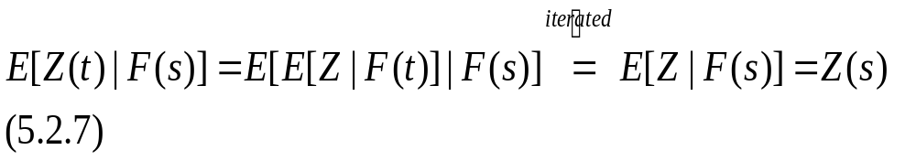
5.2.1 Girsanov’s Theorem for a Single Brownian Motion
The (5.2.6) is a martingale because of iterated conditioning (Theorem2.3.2(iii)): for,

Slide 9


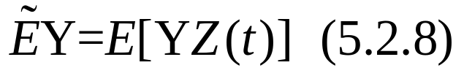
5.2.1 Girsanov’s Theorem for a Single Brownian Motion
Lemma 5.2.1. Let t satisfying be given and let Y be an -measurable random variable. Then
Proof:

Slide 10
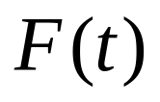
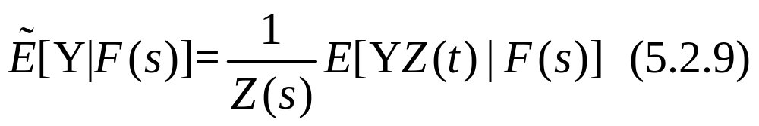
5.2.1 Girsanov’s Theorem for a Single Brownian Motion
Lemma 5.2.2. Let s and t satisfying be given and let Y be an -measurable random variable. Then

Slide 11
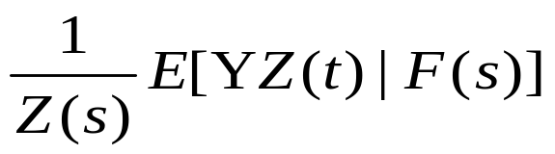

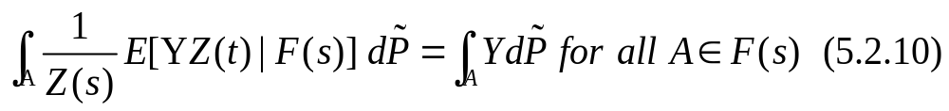
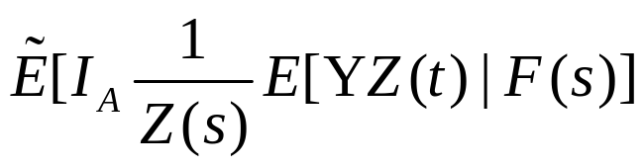
5.2.1 Girsanov’s Theorem for a Single Brownian Motion( Lemma 5.2.2)
PROOF :
: measurable
We must check the partial-averaging property (Definition 2.3.1(ii)), which in this case is
the left hand side of(5.2.10)

Slide 12
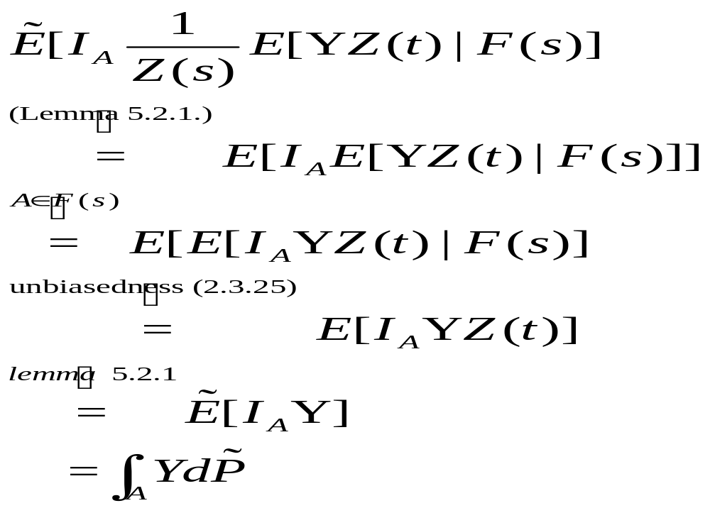
5.2.1 Girsanov’s Theorem for a Single Brownian Motion ( Lemma 5.2.2)

Slide 13
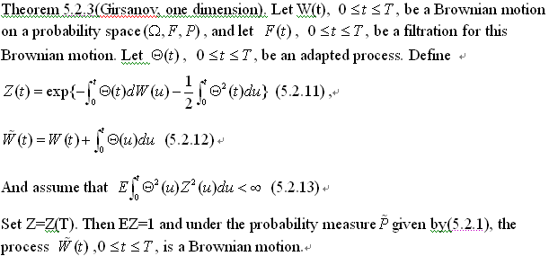
5.2.1 Girsanov’s Theorem for a Single Brownian Motion

Slide 14

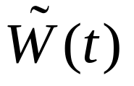
5.2.1 Girsanov’s Theorem for a Single Brownian Motion( Girsanov, one dimension)
Using Levy’s Theorem : The process starts at zero at t=0 and is continuous.
Quadratic variation=t
It remain to show that is a martingale under

Slide 15
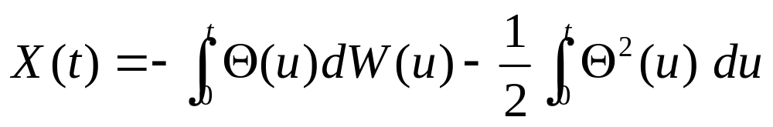
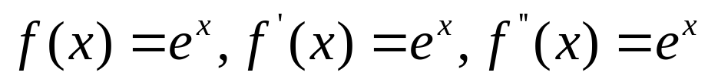
5.2.1 Girsanov’s Theorem for a Single Brownian Motion( Girsanov, one dimension)
Check Z(t) to change of measure.
We take
and Z(t)=exp{X(t)} ( f(X)=exp{X})
By Ito’s lemma( next page):

Slide 16
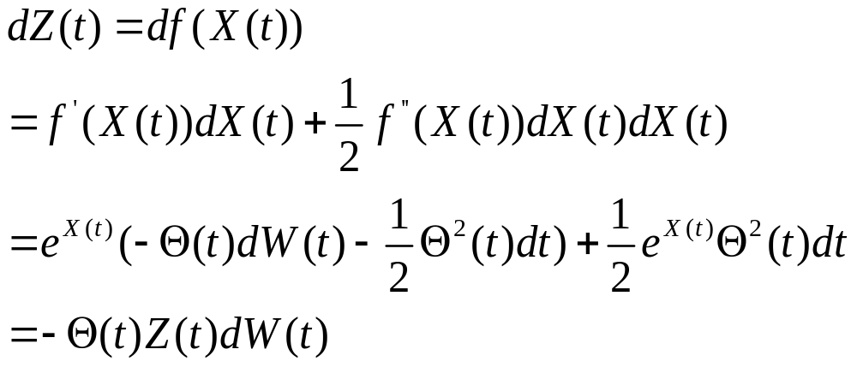
5.2.1 Girsanov’s Theorem for a Single Brownian Motion( Girsanov, one dimension)
no drift term>>martingale

Slide 17
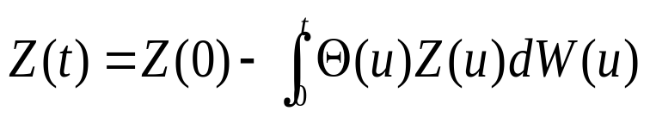
5.2.1 Girsanov’s Theorem for a Single Brownian Motion( Girsanov, one dimension)
Integrating>>
Z(t) is Ito’ integral >>Z(t)~ martingale
So ,EZ=EZ(T)=Z(0)=1.
Z(t) is martingale and Z=Z(T),we have
Z(t) is a

Slide 18

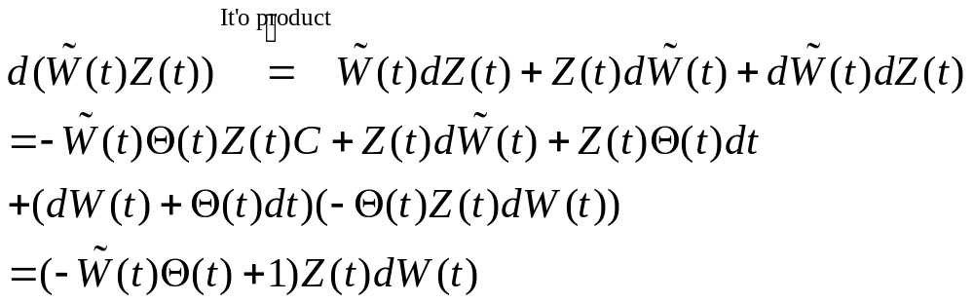
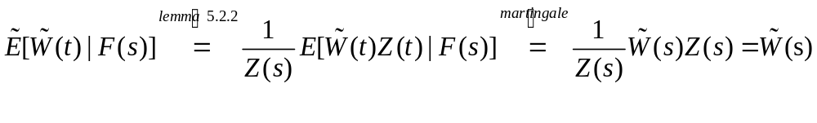


5.2.1 Girsanov’s Theorem for a Single Brownian Motion( Girsanov, one dimension)
We next show that is martingale under P
is a martingale under

Slide 19
5.2.1 Girsanov’s Theorem for a Single Brownian Motion
THE END

